Slide 1
Booking a Court Reporter or Videographer
Rev. 10/23/24 payment info.
IMPORTANT: Be sure to add no-reply@ecourtreporters.com to your safe list to ensure you receive all updates on your job requests.

Slide 2
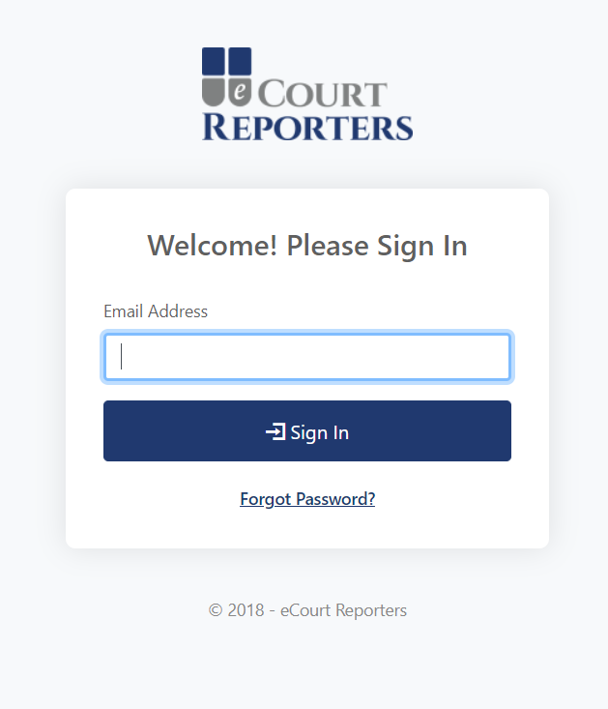
Enter your email address and password on the Sign In screen.

Slide 3
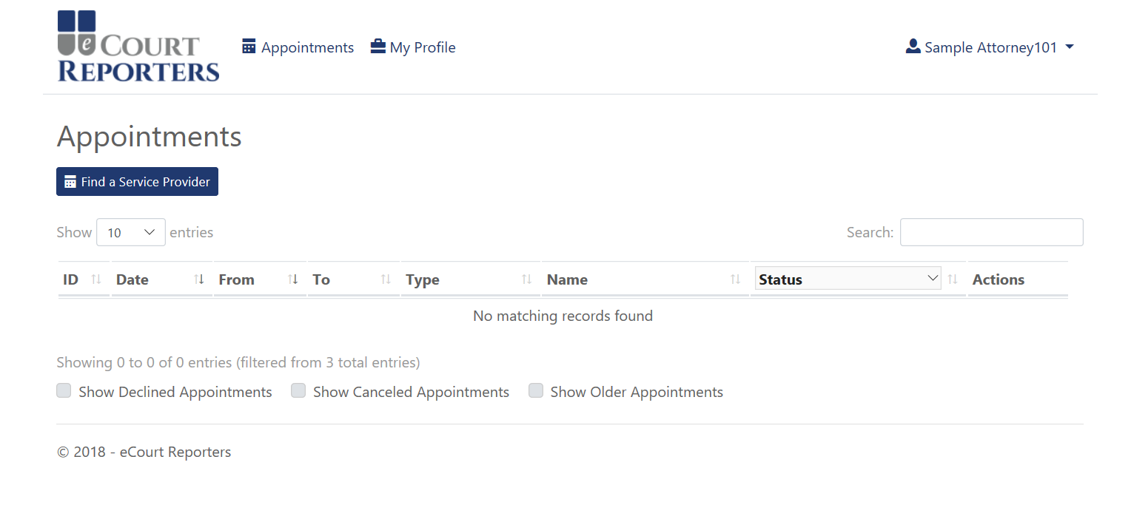
To start booking, click on “Find a Service Provider.” Once you click on this, you will be taken to our payment site. The charge to search is $49.99/month. After payment is made, you can complete your searching and booking process.
Sample Firm

Slide 4
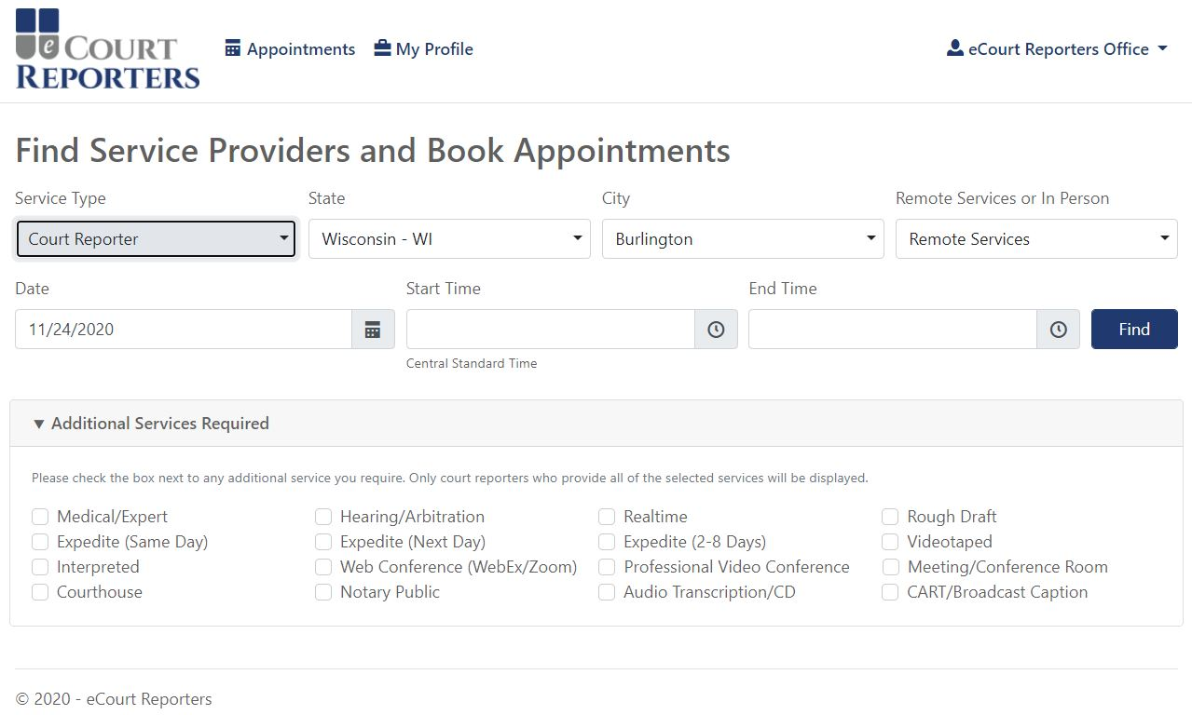
Select Service Type, State, and City. Select “Remote Services” for virtual proceeding. Use the dropdown arrow to select “In Person” to request a court reporter or videographer for appearance in person. Next select date and time and check boxes for additional services needed, if any, for proceeding.
Sample Firm
Sample Attorney101

Slide 5
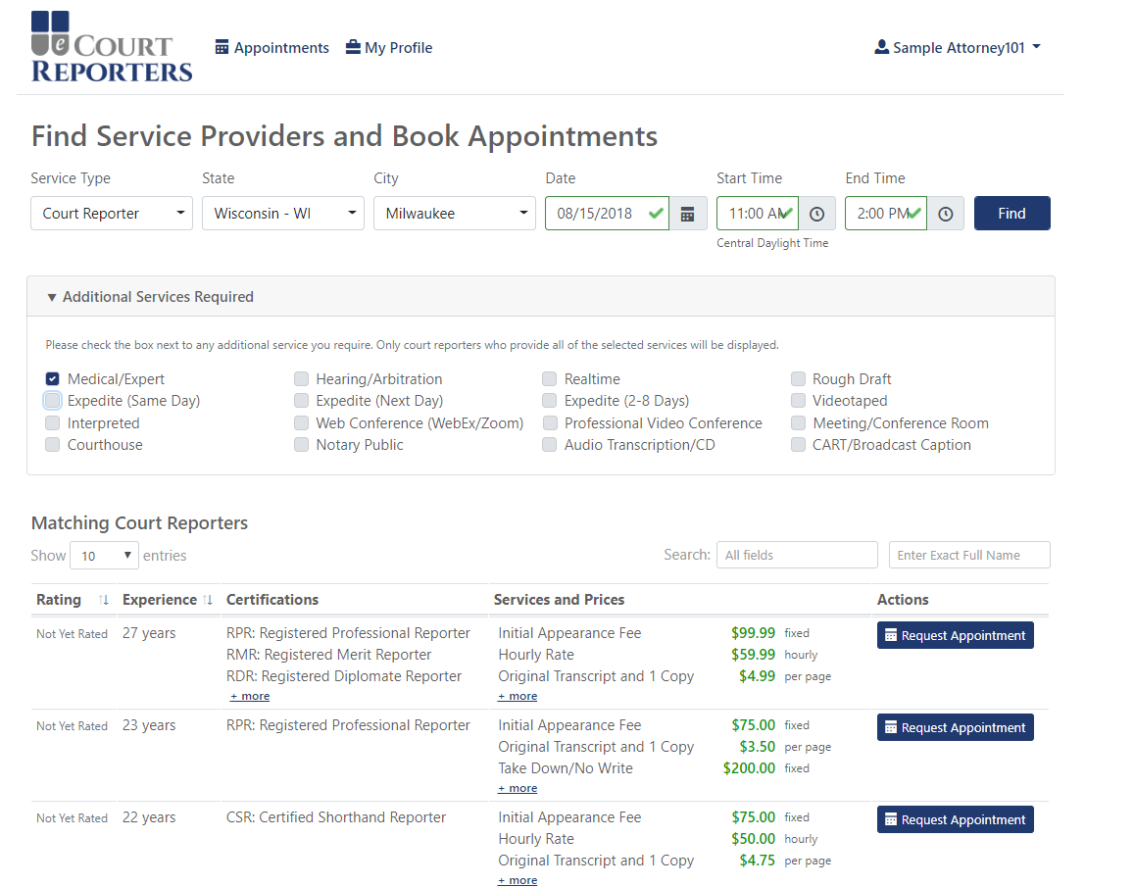
Sample Firm
Results of successful search.

Slide 6
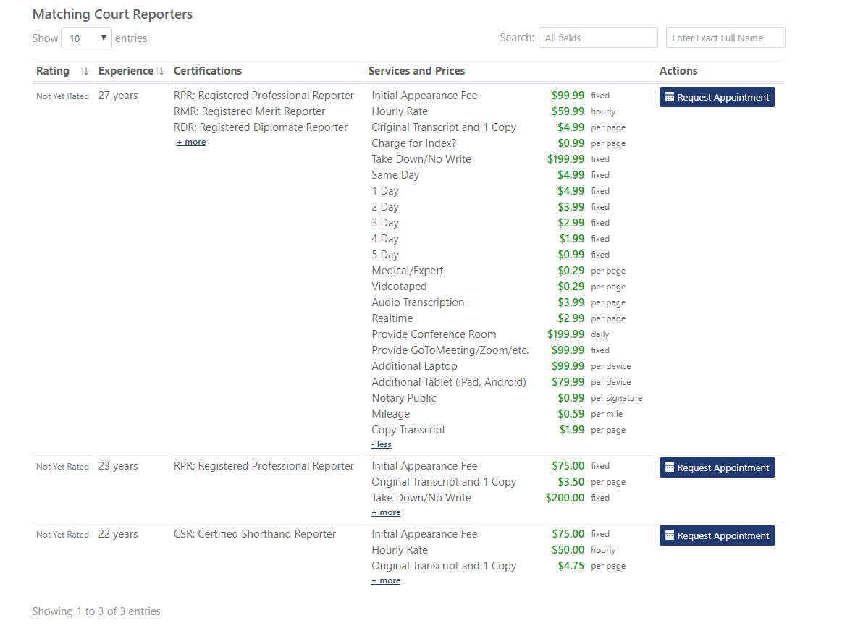
To see all rates for each service provider, click on “+more.”
Click “Request Appointment” with selection choice.

Slide 7
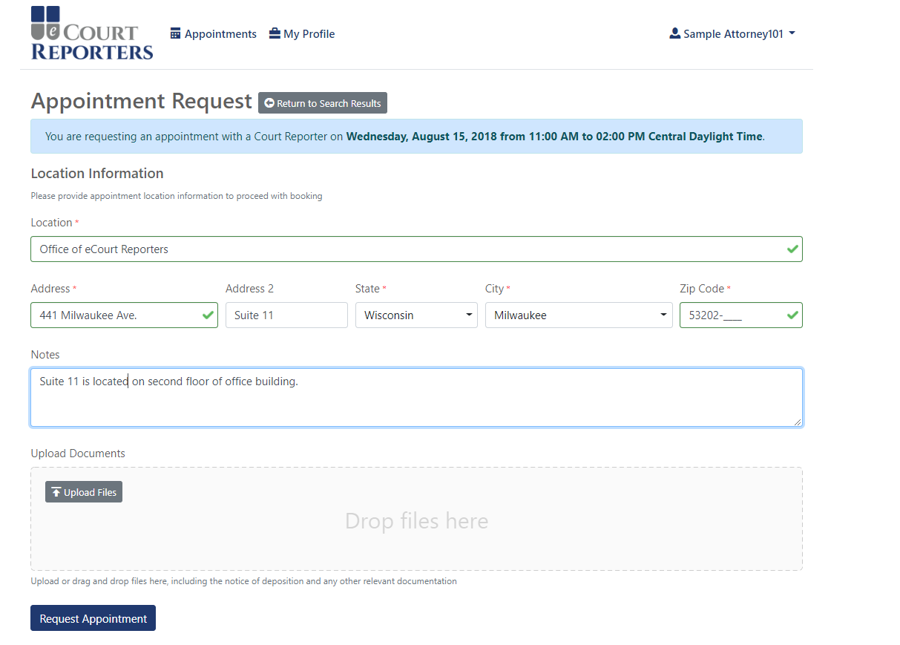
Sample Firm
Fill in appointment information.
Upload notice, caption, or any necessary files.
Click “Request Appointment.”

Slide 8
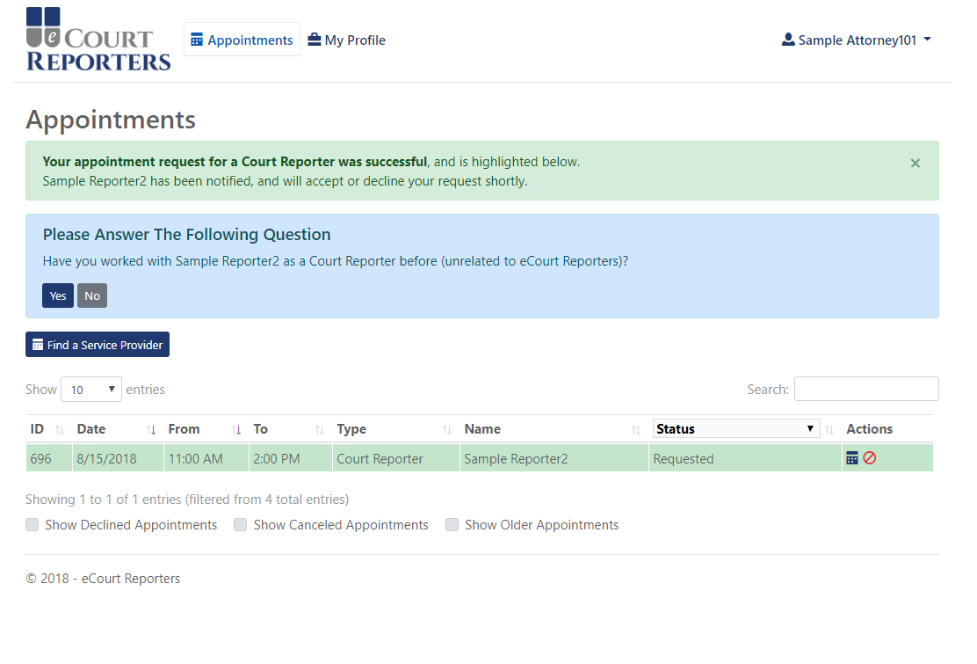
Sample Firm
A successful appointment request!

Slide 9
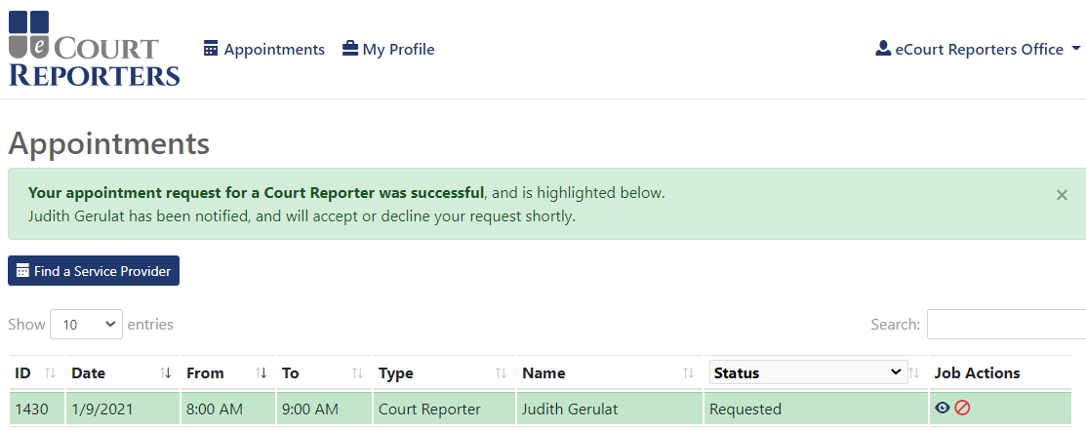
Sample Firm
For job detail information or to communicate with the service provider, click on the job icon ( ).
The service provider has been notified of the request.
You will receive an email shortly of assignment status.

Slide 10
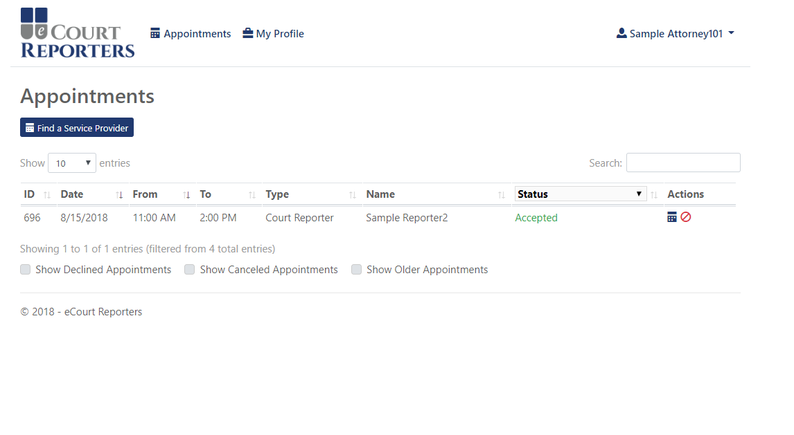
Sample Firm
Sample listing of accepted appointment.
Click on job icon ( ) to communicate with service provider.
Note: All communication must be done within the portal.

Slide 11
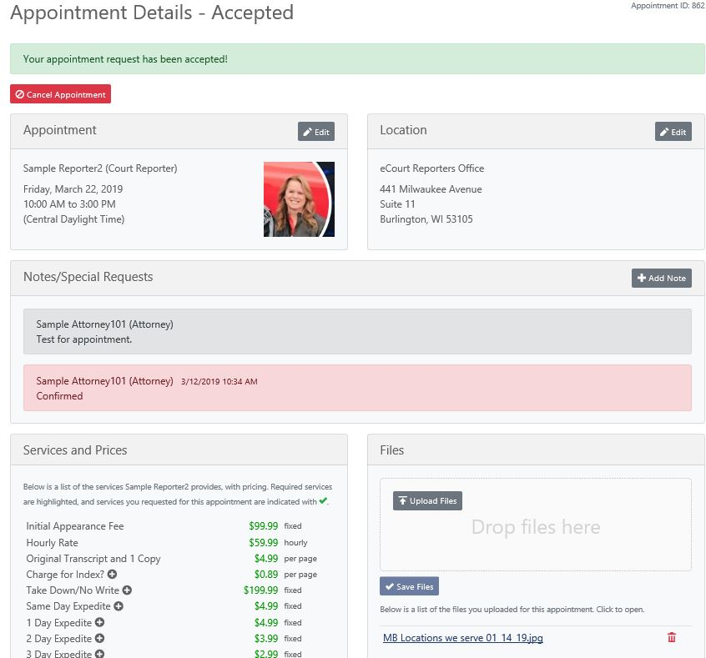
Communicate all information regarding assignment in “+Add Note.”
You can add a Zoom link (etc.) in the “+Add Note” field.
Notify service provider of job confirmation 24 hours in advance of appointment.
To add notice, caption, or other files, click “Upload Files” and “Save Files.”

Slide 12
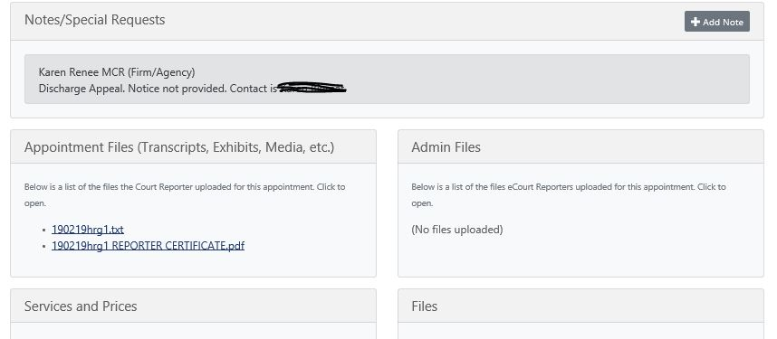
You will receive an email notification when the transcript files are uploaded in the appointment detail page.

Slide 13
Once the court reporter has uploaded the files and submitted the job sheet to eCourt Reporters, your Firm/Agency will be invoiced for the job. The invoice will reflect all the rates that were locked in upon booking PLUS a fee of 10% of the total invoice.
The Firm/Agency is responsible to pay eCourt Reporters.
eCourt Reporters then pays the court reporter or videographer.

Slide 14
www.ecourtreporters.com
Please see eCourt Reporters’ resources tab on our website for additional information or feel free to contact us:
office@ecourtreporters.com 262-210-3915
P.O. Box 250, Burlington, WI 53105

